Slide 1

IoT Enabled Smart Laboratory System
Group No. 06
Prathmesh Pande: 16104020
Ritesh Shetty: 16104048
Bhavana Kondurkar: 16104066
Project Guide: Prof. Vishal Badgujar.

Slide 2
Contents
Abstract
Introduction
Objectives
Literature Review
Problem Definition
Existing System
Proposed System
Technological Stack
Scope
Conclusion
References

Slide 3
Abstract
Automation is an area which is gaining popularity increasingly day by day since last couple of years. One can simply achieve lab automation by simply connecting the appliances to a central network or cloud storage.
The aim behind our project is to help different appliances to not just connect with each other, but with the user, in a simple, friendly manner. Here we are assuming a system which can give the user complete control over all remotely controllable aspects of their respective Laboratories.

Slide 4
Introduction
There are many devices in a laboratory, such as Lamps, Fans, Air Conditioners and Projectors.
The current and usual method to control the appliances in the lab is to manually toggle the individual switches on the switch board of the particular Lab.
However, that in itself is a time consuming task as a person has to be available to do so.
Our proposed system is aimed at developing an automated solution where even if the end-user/admin is located remotely, the appliances can be turned on.

Slide 5
Objectives
To minimize, Monetary costs, User discomfort, Delays, Utilization of resources.
To automate the appliance controlling of Labs.
To reduce the power consumption by efficient usage of the appliances.
To integrate lab timetable with the system.

Slide 6
Literature Survey
Sr. No. | 1.
Title | Design and Implementation of IOT Based Smart Laboratory
Author | M. Poongothai, P. Muthu Subramanian, A. Rajeswari.
Publisher | IEEE
Year | 2018
Methodology | Application code written for interfacing IoT smart hardware kit & MQTT broker, and for monitoring temperature, humidity and light intensity inside the laboratory Developed Dashboard and mobile application using Node-RED and ANDROID STUDIO. A database has been created for a prototype switch to view status history
Advantages | IOT reduces the human intervention by introducing device to device interaction. By employing the proposed system, the total energy consumption can be reduced in our campus.
Disadvantages | Interoperability of multiple systems, data security, standards and government policies for IoT, increasing computing power to handle the Huge amount of data generated by sensors, increasing availability of sensors and actuators to connect things in IoT.

Slide 7
Literature Survey
Sr. No. | 2.
Title | IoT Based Home Automation Using Node-Red
Author | R. K. Kodali and A. Anjum.
Publisher | IEEE
Year | 2018
Methodology | In this paper, an efficacious home automation system using low-cost Wi-Fi development boards is proposed. Node-RED, which is a visual wiring tool that helps in associating gadgets easily bringing about fast and effortless connection setups. Gadgets are linked together to ESP8266 and a Mosquito based MQTT broker using Node-RED and a connection is set up for remote monitoring and control.
Advantages | Node-Red is thus an efficient platform to link a number of IoT gadgets and can be controlled from any part of the world.
Disadvantages | With the rise in the number of gadgets on the cloud platforms, there is a requirement for refreshing firmware very often.

Slide 8
Literature Survey
Sr. No. | 3.
Title | Internet of Things (IoT) for building Smart Home System
Author | T. Malche and P. Maheshwary.
Publisher | IEEE
Year | 2017
Methodology | In this paper, they had implemented automating the home appliances using flip platform which is an open source IoT platform.
Advantages | Intrusion Detection - Intrusion detection is used for alerting user through email and text message. Smoke/Gas Detection - This application is used for sensing the smart home environment for healthy living and can also be used for security.
Disadvantages | Difficulty in achieving security

Slide 9
Literature Survey
Sr. No. | 4.
Title | IoT Based Smart Security and Home Automation
Author | S. Somani, P. Solunke, S. Oke, P. Medhi and P. P. Laturkar.
Publisher | IEEE
Year | 2018
Methodology | This paper focuses on a system that provides features of Home Automation relying on Internet of Things to operate easily, in addition to that it includes a camera module and provides home security.
Advantages | Enhance the IoTs' network security using encryption and decryption of the user's data.
Disadvantages | Lack of an intuitive UI, high base cost.

Slide 10
Literature Survey
Sr. No. | 5.
Title | A step towards Home Automation using IOT.
Author | H. K. Singh, S. Verma, S. Pal and K. Pandey.
Publisher | IEEE
Year | 2019
Methodology | This paper is to develop home automation system based on IOT using Wi-Fi based microcontroller. NodeMCU (ESP8266) microcontroller along with Relays is used to control electrical switches remotely from the server which is built on Node.js. User can control switches using a Web Application after authenticating.
Advantages | This system is quite effective in terms of performance and technology. The device can be an android device, a remote controller or a smart watch, for controlling the appliances.
Disadvantages | As technology is changing every second so, it is very important that our paper should use current technology (IoT). Most of the work on "IOT based home automation” are yet incomplete and requires a final implementation on field.

Slide 11
Problem Definition
Our institute has an abundance of laboratories and hence, more staff. Some staff have different working patterns than others.
Every time if a lab session ends, more often the machines and appliances are left running.
Physically toggling the individual lights, fans and systems in the beginning of a lab session adds to the wastage of time of the session.
A solution should be developed where everything is controlled remotely to save time, power consumption and also energy in terms of man power.

Slide 12
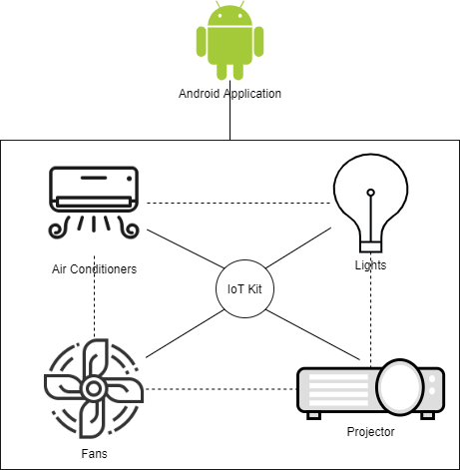
Existing System

Slide 13
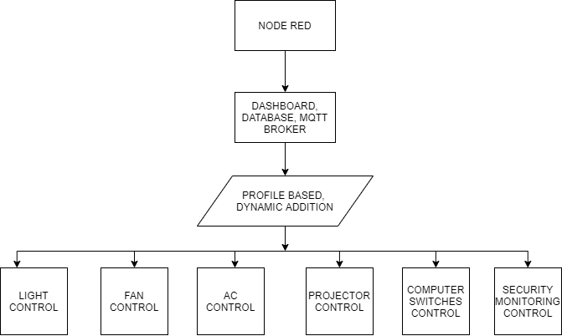
Proposed System

Slide 14
Technological Stack
Embedded boards like Arduino, NodeMCU or Raspberry Pi for programming appliances.
Node-red for web interface and cross-platform compatibility.
SQLite for storing IoT data.
MQTT For Communication.
Machine Learning to change the state of the appliances based on the behaviour of the user.

Slide 15
Scope
The Expected system will ease the whole automation process in labs and make the Lab management easier.
The proposed system can not only be used for colleges and universities, but also at homes, studios, and many other places.
The system will be capable of controlling devices which include Include controlling of computer switches, curtains, lights, fans, projectors and also include fire detection.

Slide 16
Conclusion
Considering the aforementioned problems in our university, we have listed the issues and found out the solutions to minimize the workload for the lab assistants and faculty members to the maximum.
The node-red GUI dashboard is accessible via browser, it ensures cross-platform compatibility.
Adding some ‘smarter’ components to our life makes our lives easier, and more flexible in terms of day to day usage.
The main objective of our project is to reduce the human efforts in labs, which we think can be achieved using lab automation.

Slide 17
References
M. Poongothai, P. M. Subramanian and A. Rajeswari, "Design and implementation of IoT based smart laboratory," 2018 5th International Conference on Industrial Engineering and Applications (ICIEA), Singapore, 2018, pp. 169-173.
R. K. Kodali and A. Anjum, "IoT Based HOME AUTOMATION Using Node-RED," 2018 Second International Conference on Green Computing and Internet of Things (ICGCIoT), Bangalore, India, 2018, pp. 386-390.
T. Malche and P. Maheshwary, "Internet of Things (IoT) for building smart home system," 2017 International Conference on I-SMAC (IoT in Social, Mobile, Analytics and Cloud) (I-SMAC), Palladam, 2017, pp. 65-70.
S. Somani, P. Solunke, S. Oke, P. Medhi and P. P. Laturkar, "IoT Based Smart Security and Home Automation," 2018 Fourth International Conference on Computing Communication Control and Automation (ICCUBEA), Pune, India, 2018, pp. 1-4.
H. K. Singh, S. Verma, S. Pal and K. Pandey, "A step towards Home Automation using IOT," 2019 Twelfth International Conference on Contemporary Computing (IC3), Noida, India, 2019, pp. 1-5.

